Slide 1
Lecture-3

Slide 2
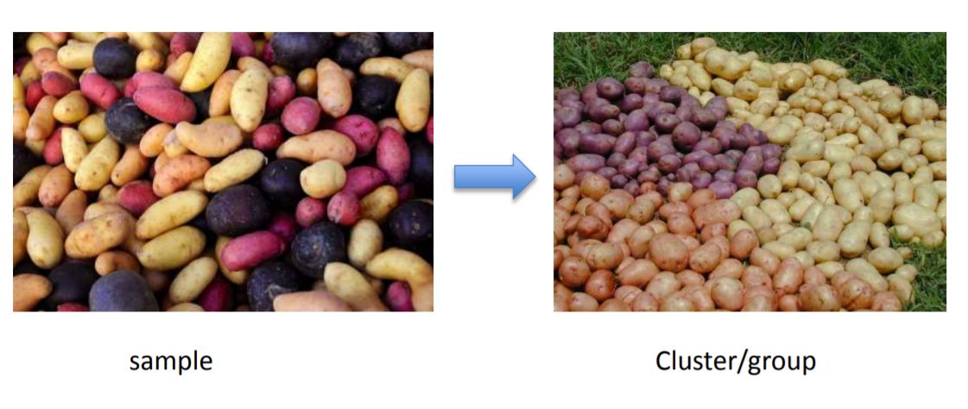
Clustering
Gathering samples into groups of similar samples according to some predefined similarity or dissimilarity measure.

Slide 3
WHY CLUSTERING?
Image Segmentation
Knowledge Discovery in Data
Clusty and Clustering Genes Above
Notes:
Image Segmentation: K means clustering algorithm can be used for image segmentation.
KDD: Clustering algorithms can be used for the extraction of underlying rules,recurring patterns in a knowledge base.
Clusty and Clustering Genes: Organizing data into clusters provides information about the internal structure of the data.

Slide 4
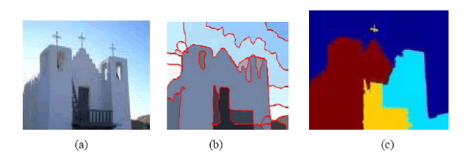

Slide 5
What is Good Clustering ?
In which:
– the intra-class (that is, intra intra-cluster) similarity is high.
– the inter-class similarity is low.
Intra-cluster distance is the distance between a data item and the cluster centroid within a cluster. Inter-cluster distance is the distance between the data items in distinct clusters.
Intra-cluster distance is the distance between two objects belonging to same cluster.

Slide 6
Examples where clustering are used?
Market segmentation - group customers into different market segments.
Social network analysis - Facebook "smartlists"
Document classification

Slide 7
Desirable Properties of CLustering Algorithm
Scalability (in terms of both time and space)
Ability to deal with different data types
Minimal requirements for domain knowledge to determine input parameters
Interpretability and usability

Slide 8
K means Clustering Algorithm
Given k, the k-means algorithm works as follows:
1. Choose k (random) data points (seeds) to be the initial centroids, cluster centers
2. Assign each data point to the closest centroid
3. Re-compute the centroids using the current cluster memberships
4. If a convergence criterion is not met, repeat steps 2 and 3

Slide 9
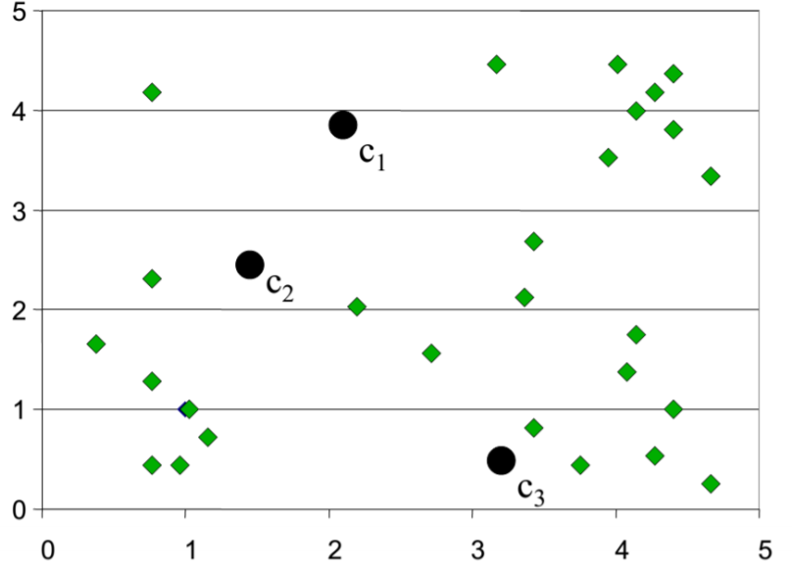
Random Initialization of Cluster Centers

Slide 10
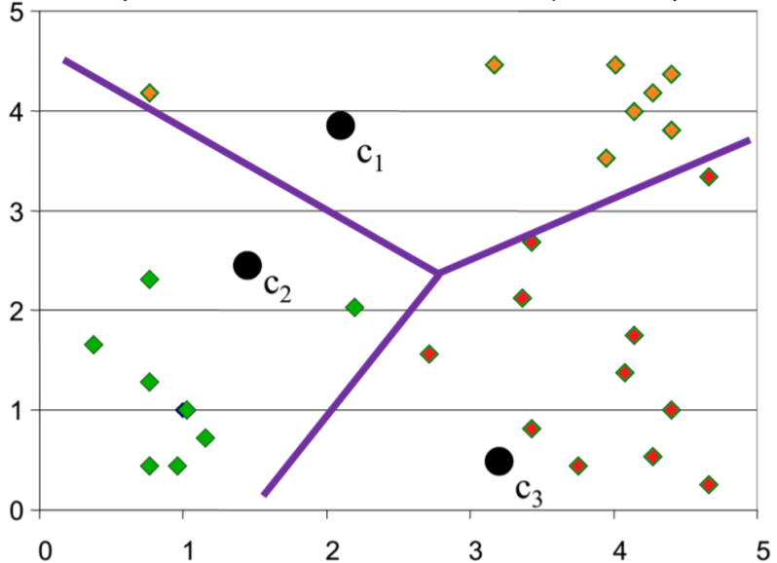
Determination of Cluster membership for each input

Slide 11
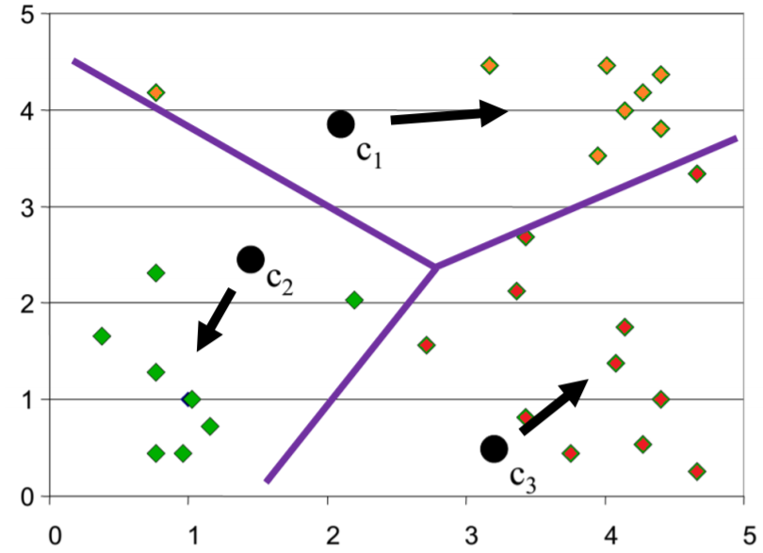
Re-estimation of Cluster Centers

Slide 12
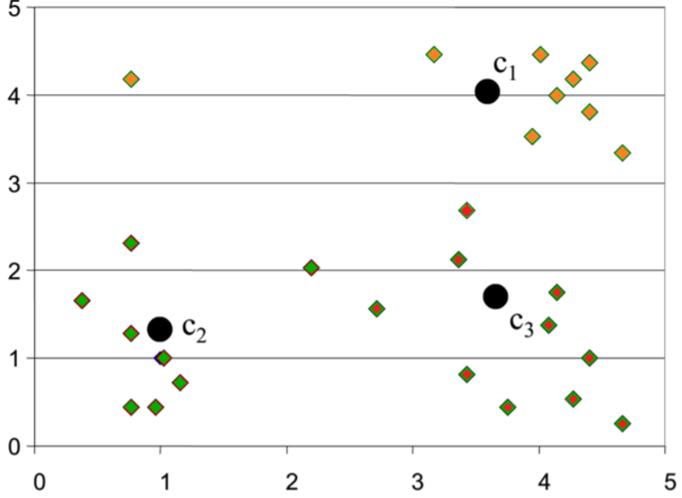
Result from first iteration

Slide 13
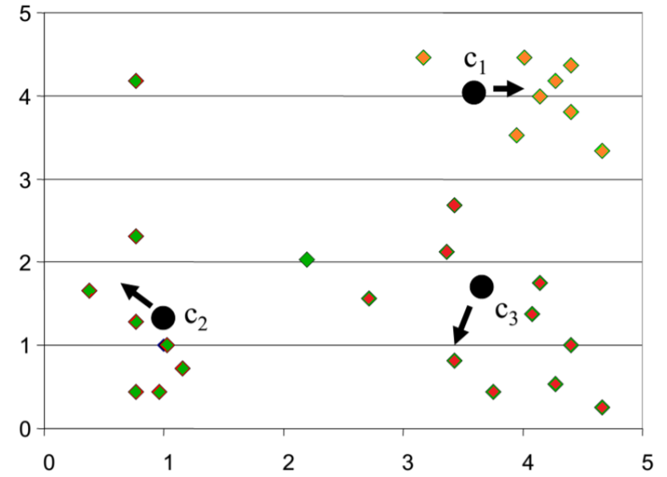
Result from second Iteration

Slide 14
Mathematical Interpretation
Cluster following numbers using k means clustering algorithm where k =2.
{2,3,4,10,11,12,20,25,30}
Hints:
1. Take assumed k mean value
2. Find nearest numbers of mean and put in cluster.
3. Repeat steps 1 and 2 until we get the same mean values.

Slide 15
Common ML Algorithms
Decision Tree
K Nearest Neighbour
Support Vector Machine
Naive Bayes Classifier

Slide 16
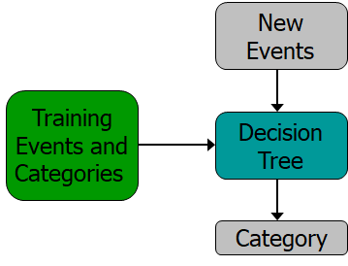
Decision Tree Algorithm
Powerful supervised algorithm for both classification and regression
Represent rules in the form of a tree structure which can be understood by humans.

Slide 17
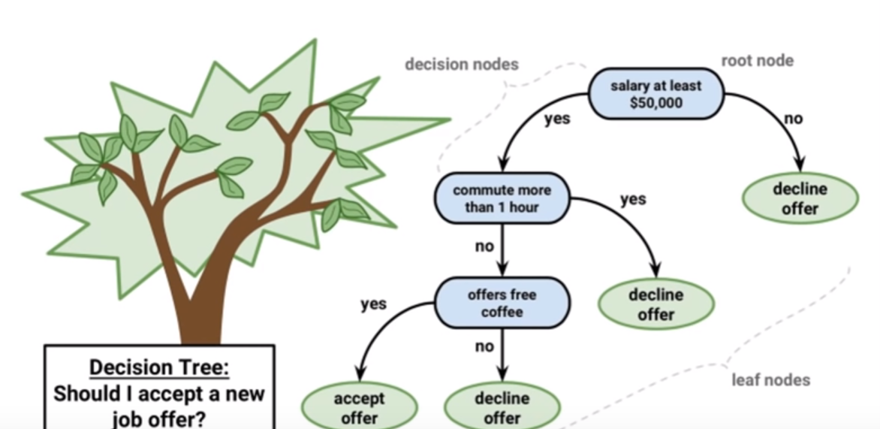
Graphical Representation of all possible solutions to a decision based on certain conditions.

Slide 18
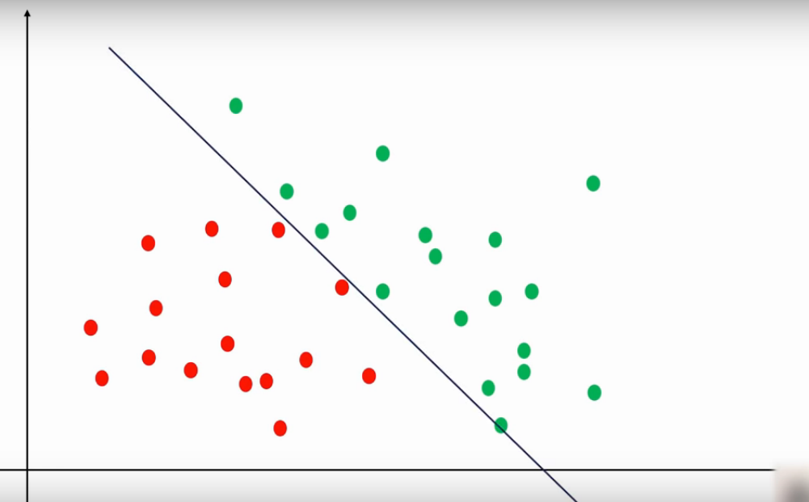

Slide 19
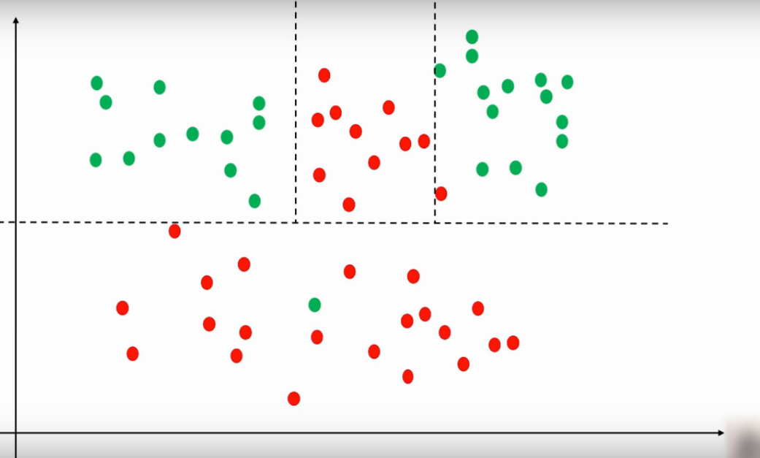

Slide 20
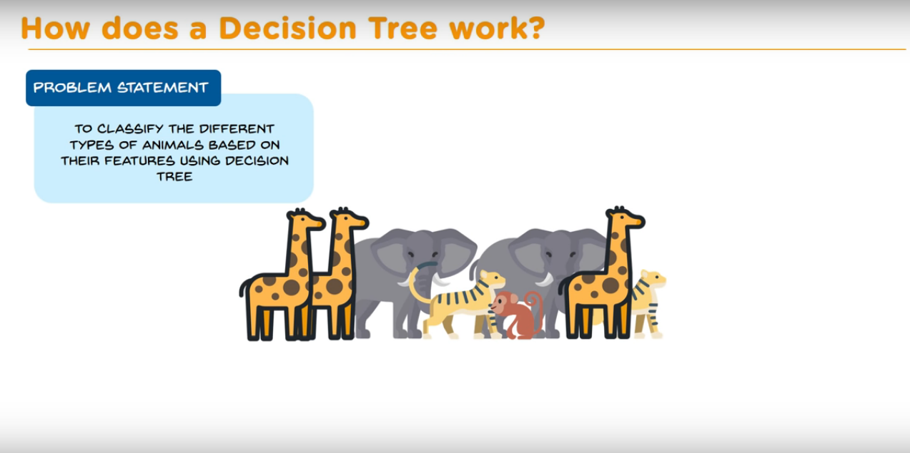

Slide 21
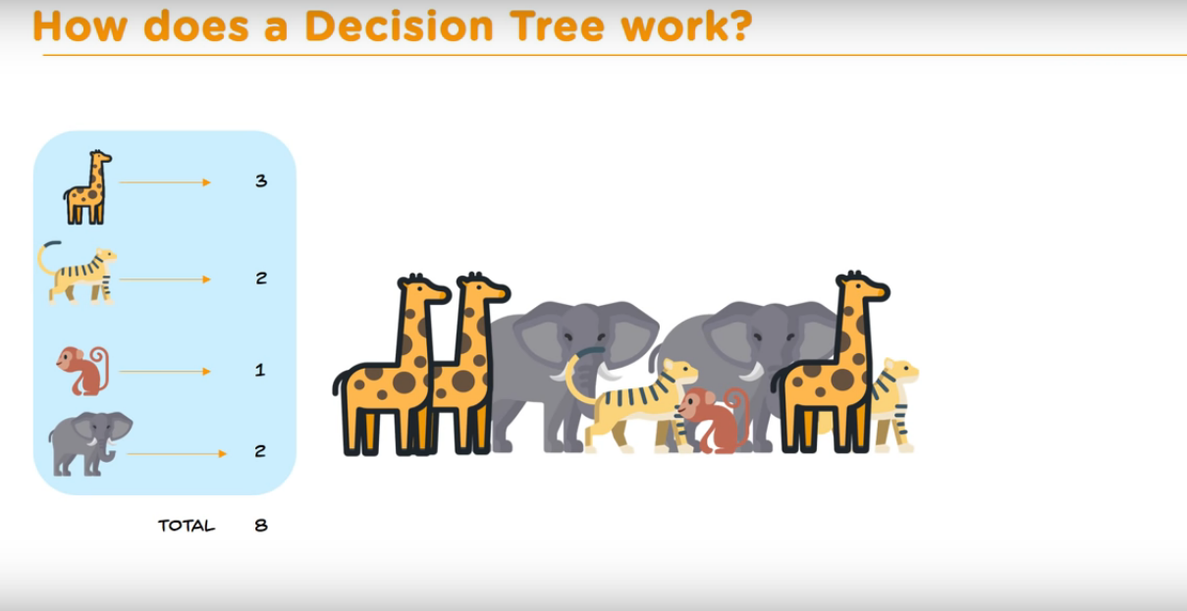

Slide 22
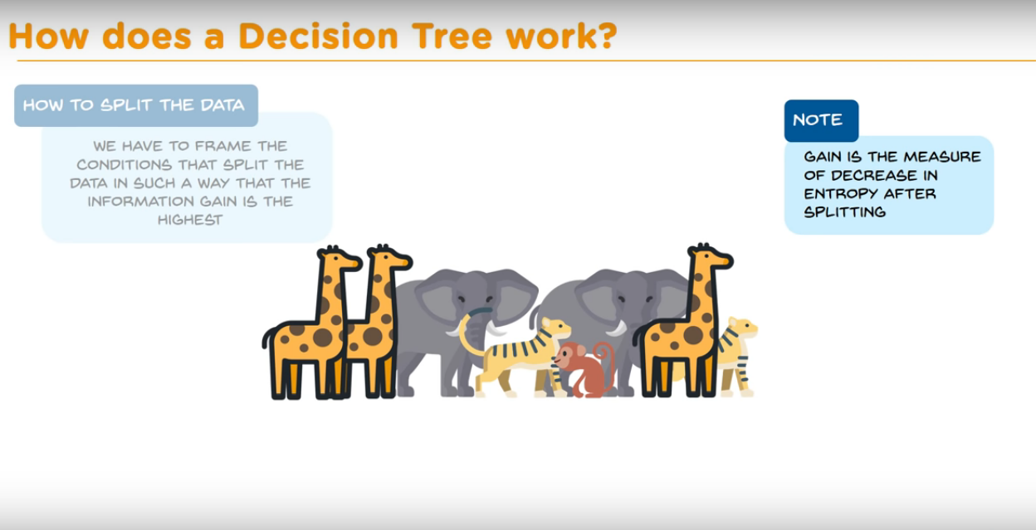

Slide 23
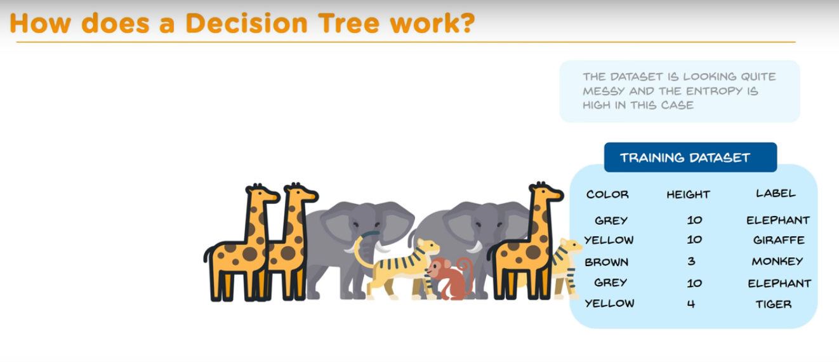

Slide 24
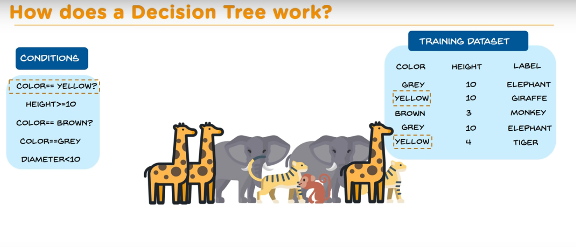

Slide 25
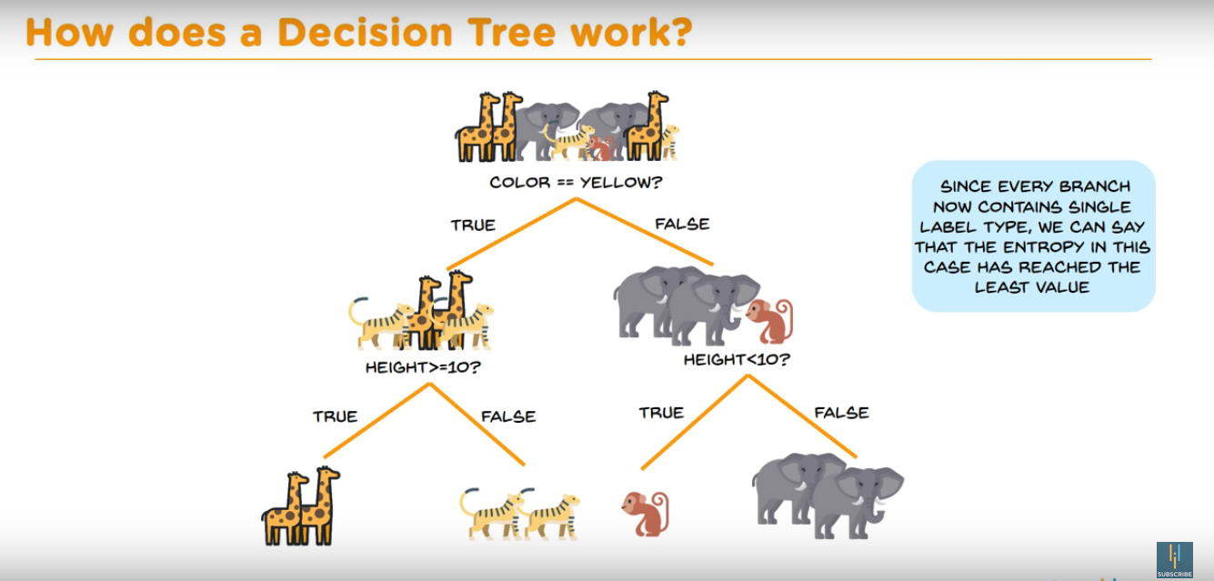

Slide 26
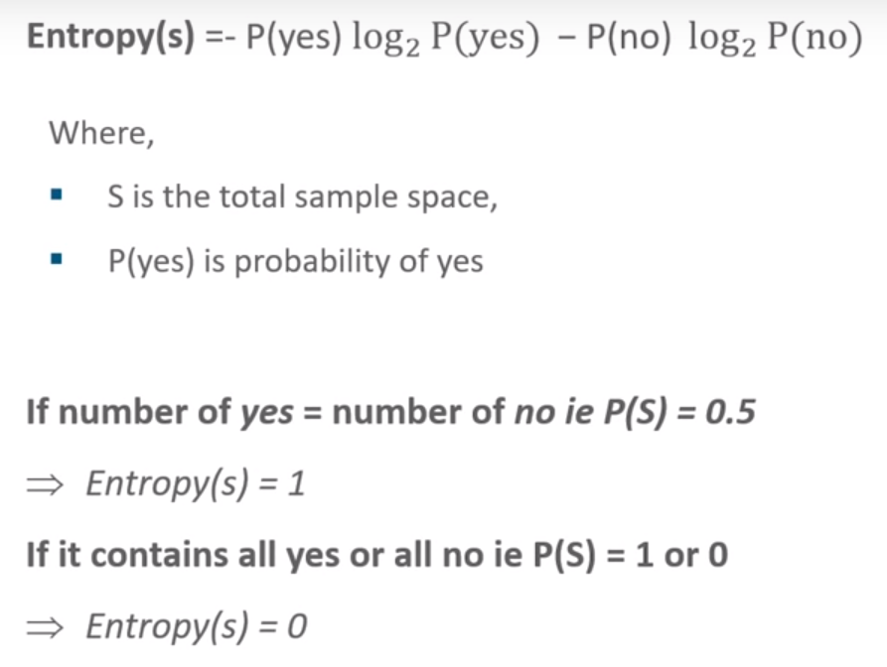
Entropy
Defines randomness(impurity) in data
First step to solve the problem of decision tree

Slide 27
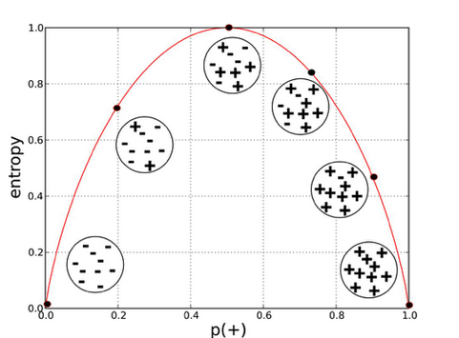

Slide 28
Information Gain
Measures the reduction in entropy
Decides which attribute should be selected as the decision node
If S is our total collection, then
Information Gain = Entropy(S) - [(Weighted Avg) * Entropy(each feature)]

Slide 29
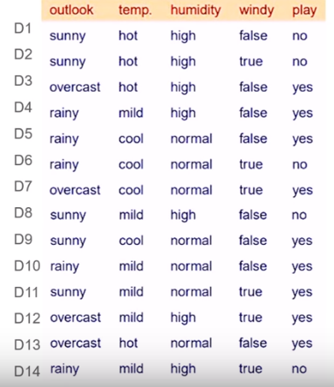
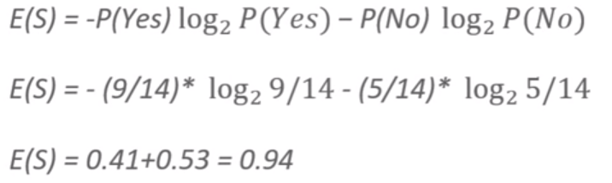
Training data
Computing Entropy for this data

Slide 30
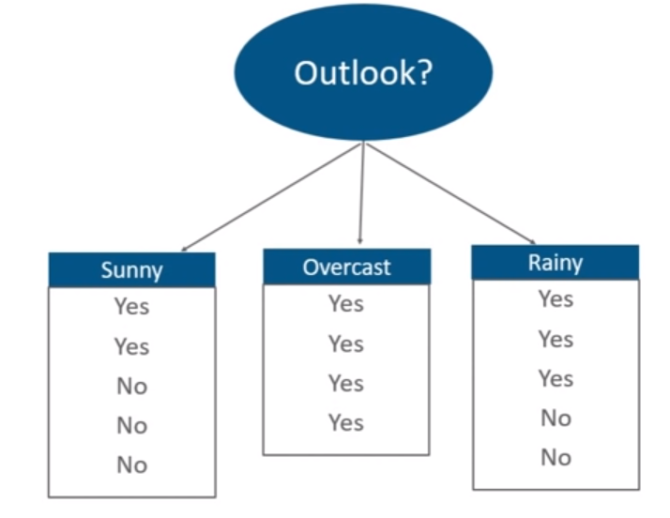
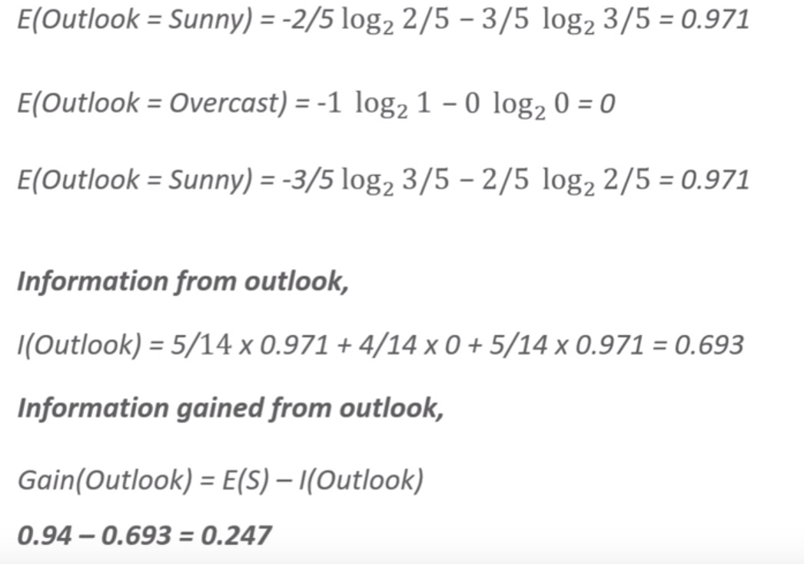
Information Gain for outlook

Slide 31
Information Gain from other attributes
Outlook : 0.247
Temperature : 0.029
Humidity : 0152
Windy : 0.048

Slide 32
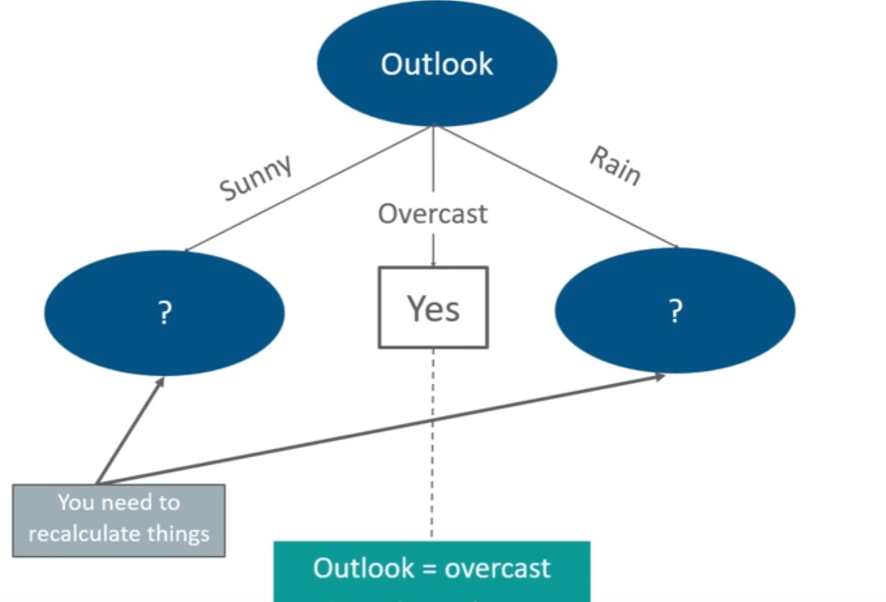
Now our decision tree will build like this

Slide 33
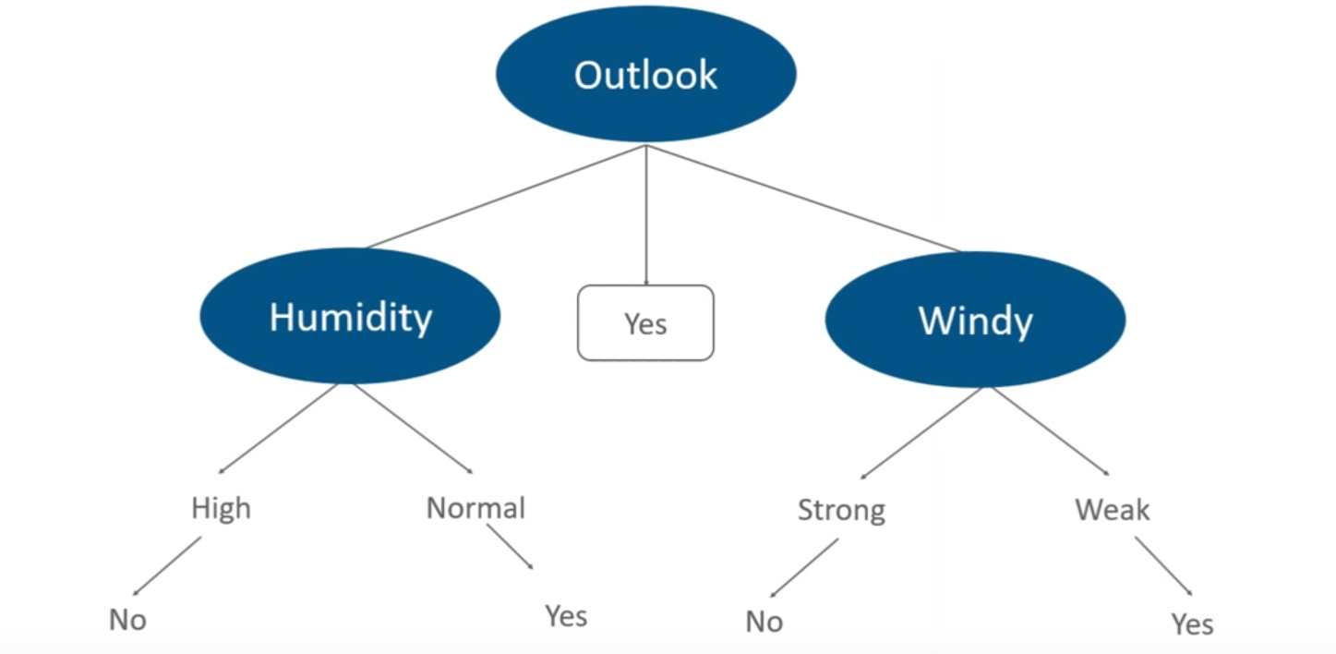
Finally, our decision tree will look like

Slide 34
K-Nearest Neighbors(KNN) Algorithm
KNN algorithm is one of the simplest classification algorithm
KNN can be used in regression as well as classification, but is primarily used in classification.
KNN is a non-parametric, lazy learning algorithm
KNN is a model that classifies data points based on the points that are most similar to it
KNN Algorithm is based on feature similarity:
How closely out-of-sample features resemble our training set determines how we classify a given data point:

Slide 35
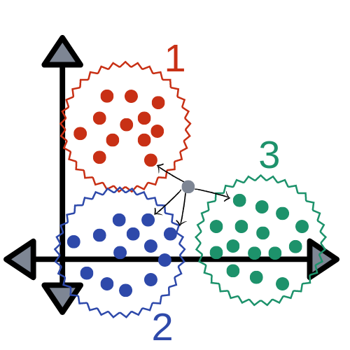

Slide 36
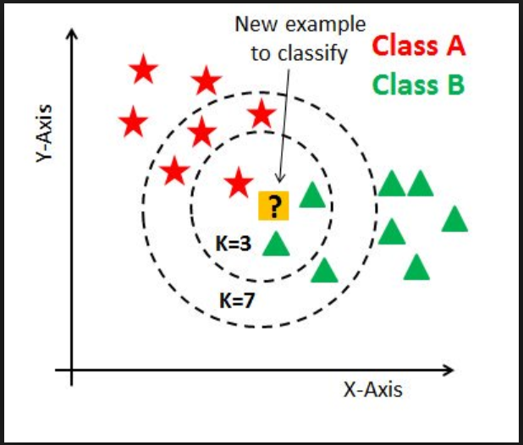
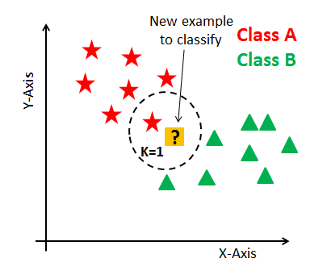
K in KNN
K in KNN stands for number of nearest neighbours

Slide 37
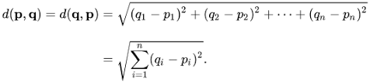
The KNN Algorithm-Steps
The first step is to transform data points into feature vectors, or their mathematical value.
Algorithm then works by finding the distance between the mathematical values of these points.
The most common way to find this distance is the Euclidean distance.

Slide 38
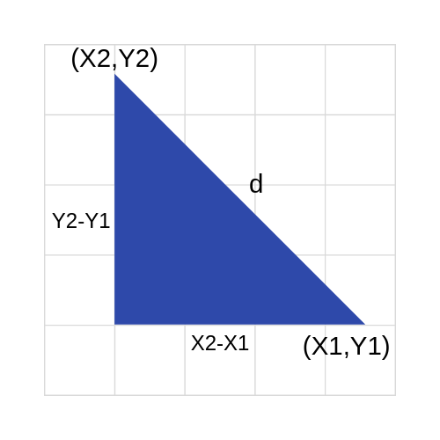
Distance Formula
To visualize this formula, it would look something like this:

Slide 39
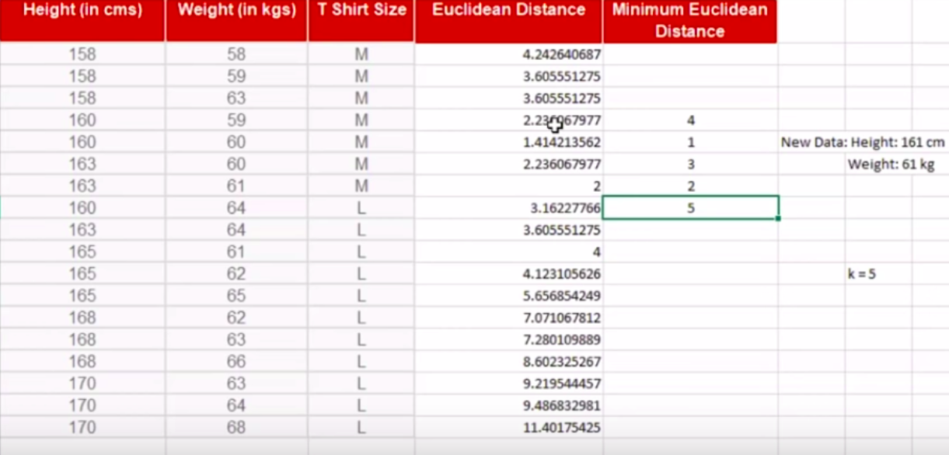

Slide 40
Where KNN is used
KNN classification can be effectively used as an outlier detection(i.e fraud)
KNN is often used in simple recommendation systems, image recognition technology, and decision-making models.
It is the algorithm companies like Netflix or Amazon use in order to recommend different movies to watch or books to buy.

Slide 41
Why KNN is Handy
It is extremely easy to implement
No training prior to making real time predictions.
KNN algorithm much faster than other algorithms that require training e.g SVM, linear regression, etc.
Since the algorithm requires no training before making predictions, new data can be added seamlessly.
There are only two parameters required to implement KNN i.e. the value of K and the distance function (e.g. Euclidean or Manhattan etc.)

Slide 42
K-Means Implementation
Using scikit learn

